Slide 1
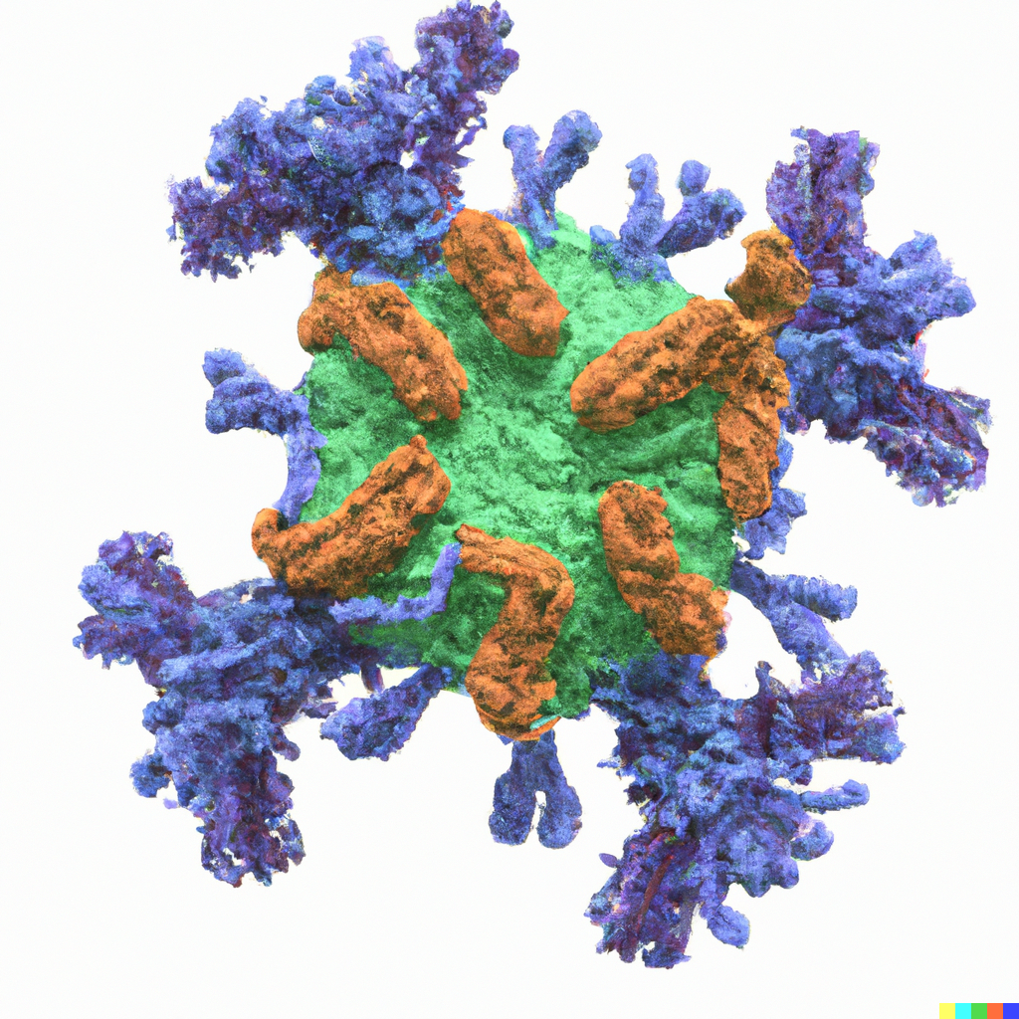
Machine learning approach to model β-strand interaction
Imperial UROP Project
Haowen Zhao

Slide 2
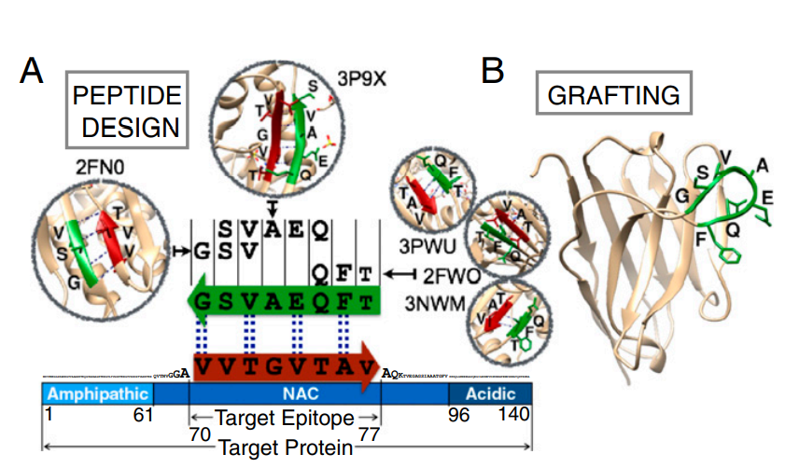
Motivation
Cascade method
Fig. 1. Sormanni, P., Aprile, F. A., & Vendruscolo, M. 2015. PNAS.
Objective
For arbitrary target sequence (within length 8), a model that provides diverse ranked complementary peptides that mimics PDB β-strand interaction.

Slide 3
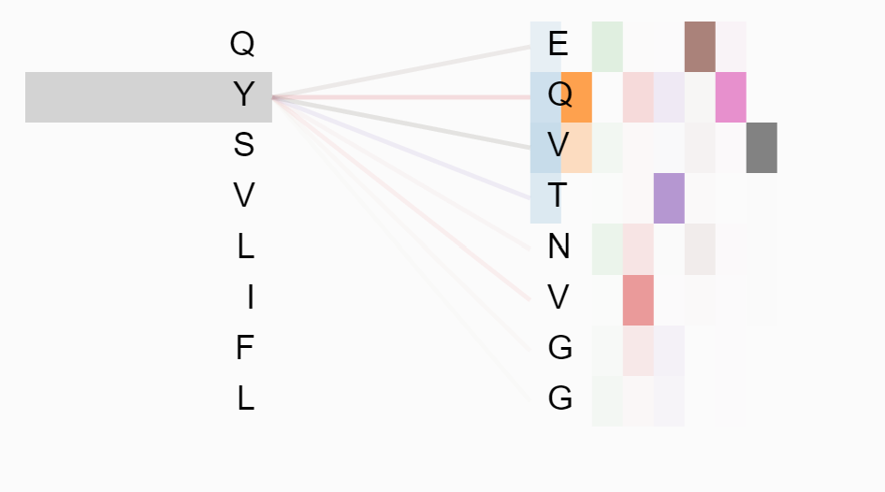
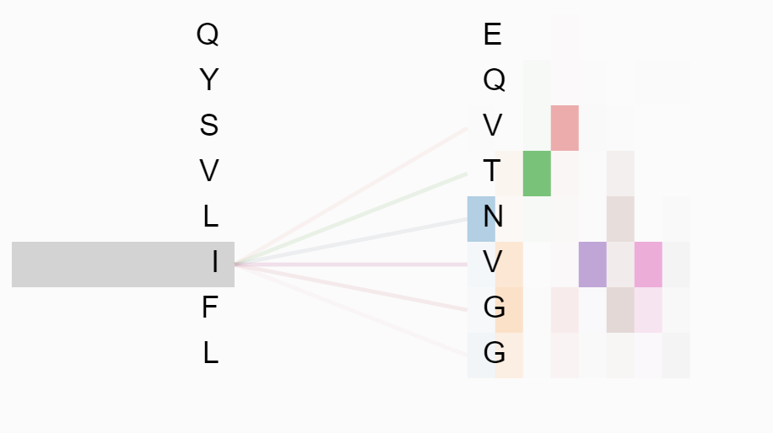
Current Work
PDB Data preparation
Model architecture
Model validation results
Model simulations on α-Synuclein, Aβ42, IAPP
Model interpretability
Discussion

Slide 4
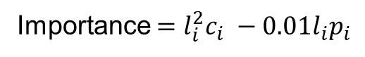
Data preparation
Importance $=l_{i}^{2}c_{i} −0.01l_{i}p_{i}$
Target sequence | Complementary peptides | Importance score
PQI | ADY | 8.82
PQI | YGC | 8.76
PQI | IGG | 7.74
PQI | VTG | 7.23
PQI | ELR | 6.75
MLGVTFE | ALSFETK | 49.0
MLGVTFE | VYTKTLR | 49.0
Target sequence | Complementary peptides | Count | Promiscuity | Hydrogen bond pattern | Type
PQI | ADY | 1 | 6 | (None, None), (-1, 1), (None, None) | 0
 | YGC | 1 | 8 | (None, None), (-1, 1), (None, None) | 0
 | IGG | 1 | 42 | (None, None), (-1, 1), (None, None) | 0
 | VTG | 1 | 59 | (None, None), (-1, 1), (None, None) | 0
 | ELR | 1 | 75 | (None, None), (-1, 1), (None, None) | 0
MLGVTFE | ALSFETK | 1 | 0 | (None, None), (0, 0), (None, None), (0, 0), (None, None), (0, 0), (None, None) | 1
 | VYTKTLR | 1 | 0 | (0, 0), (None, None), (0, 0), (None, None), (0, 0), (None, None), (0, 0) | 1
Original data
Processed data (2105108 samples)
Test data
(5000 length-8 samples)
Training data (2100108 samples)

Slide 5
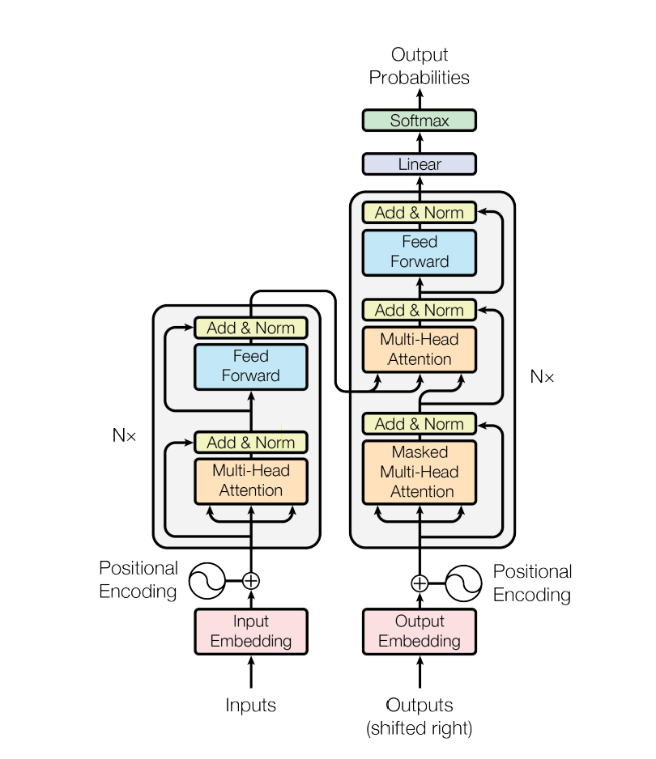
Model architecture
Transformer architecture
Transformer models
BERT
GPT 1/2/3
Swin Transformer
Codex
Alphafold 2
BERTology
Figure 1. Vaswani et al. 2017. arXiv.

Slide 6
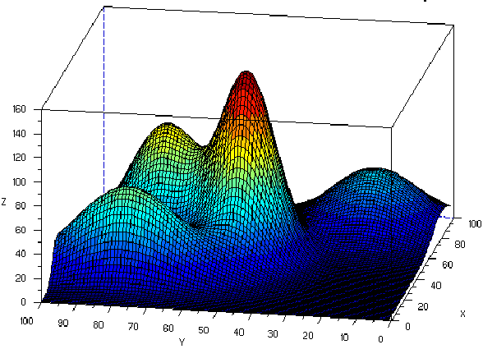
Model architecture – probabilistic model
$$Prob （Complementary peptides ｜ Target）$$
Most probable complementary peptide
Less probable, but different structured complementary peptide

Slide 7
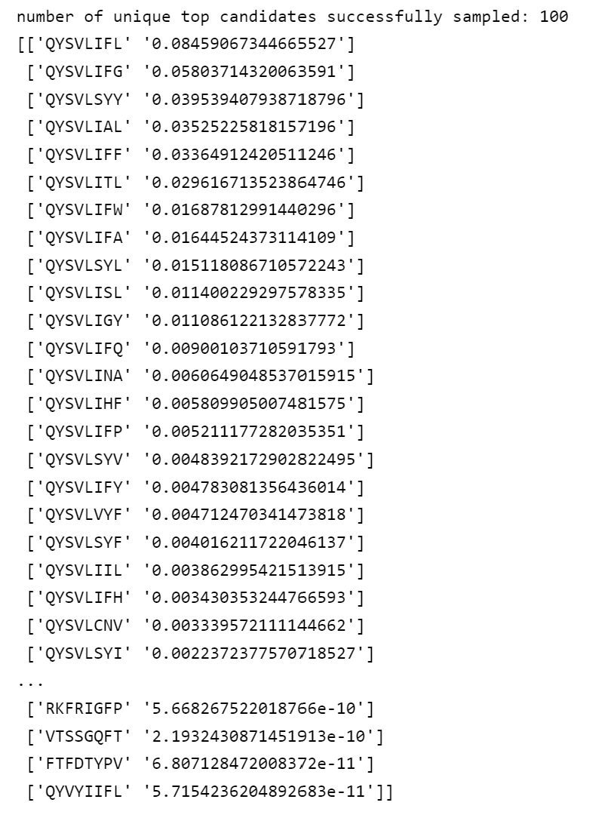
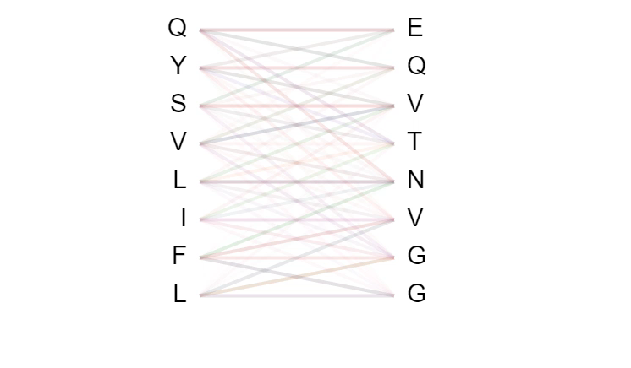
Model architecture – sampling from probabilistic model
Method 1: Greedy Prediction
Generate one most probable prediction
The algorithm is very efficient
Method 2: Sampling Prediction
Generate infinitely many diverse ranked predictions
The algorithm is less efficient

Slide 8
Model validation results
The model make greedy predictions on 5000 unseen length-8 data Then we check whether PDB label is successfully predicted
Model wide
Number of parameters: 29,437,976
Sequence successfully predicted: 4654
Sequence prediction accuracy: 93.08%

Slide 9
Model validation results
The model make sampling predictions on 5000 unseen length-8 data
For each target, top 100 are sampled and ranked
We check whether PDB label is successfully generated in top 100 predictions
Ranking of model generation

Slide 10
Model validation results

Slide 11
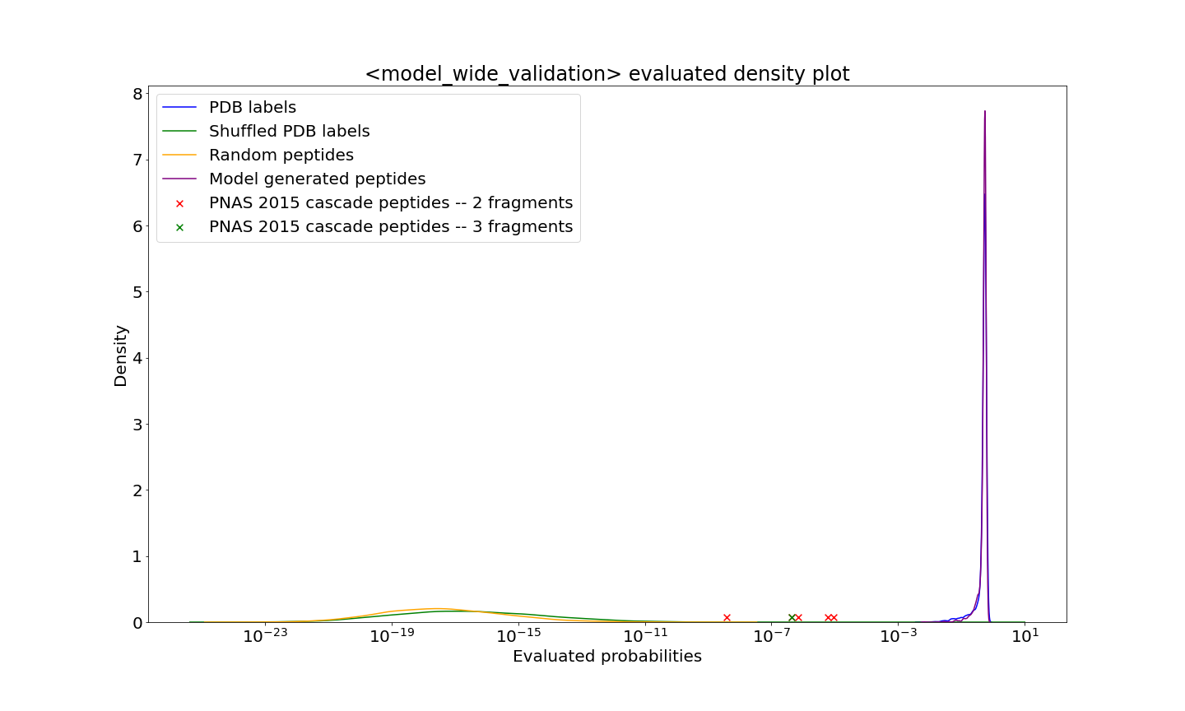
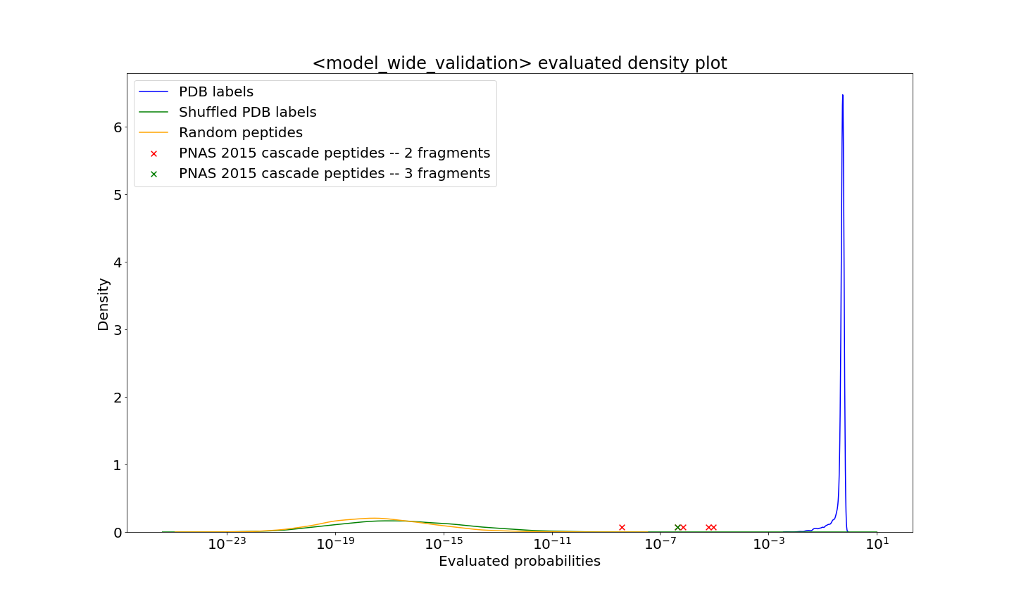
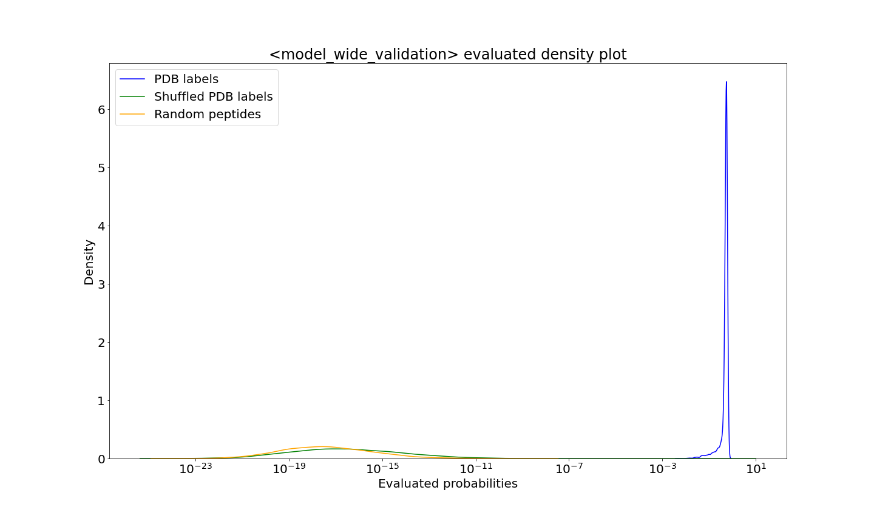
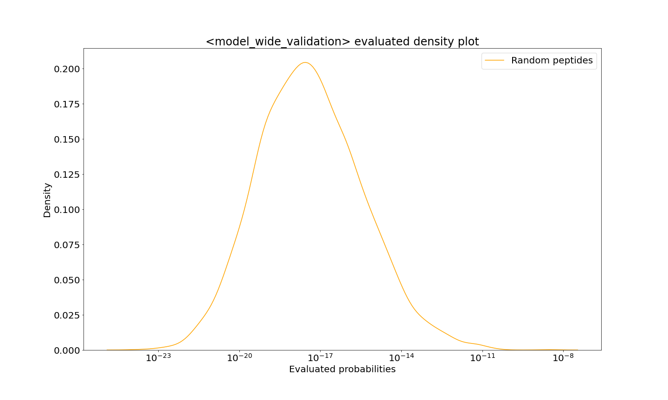
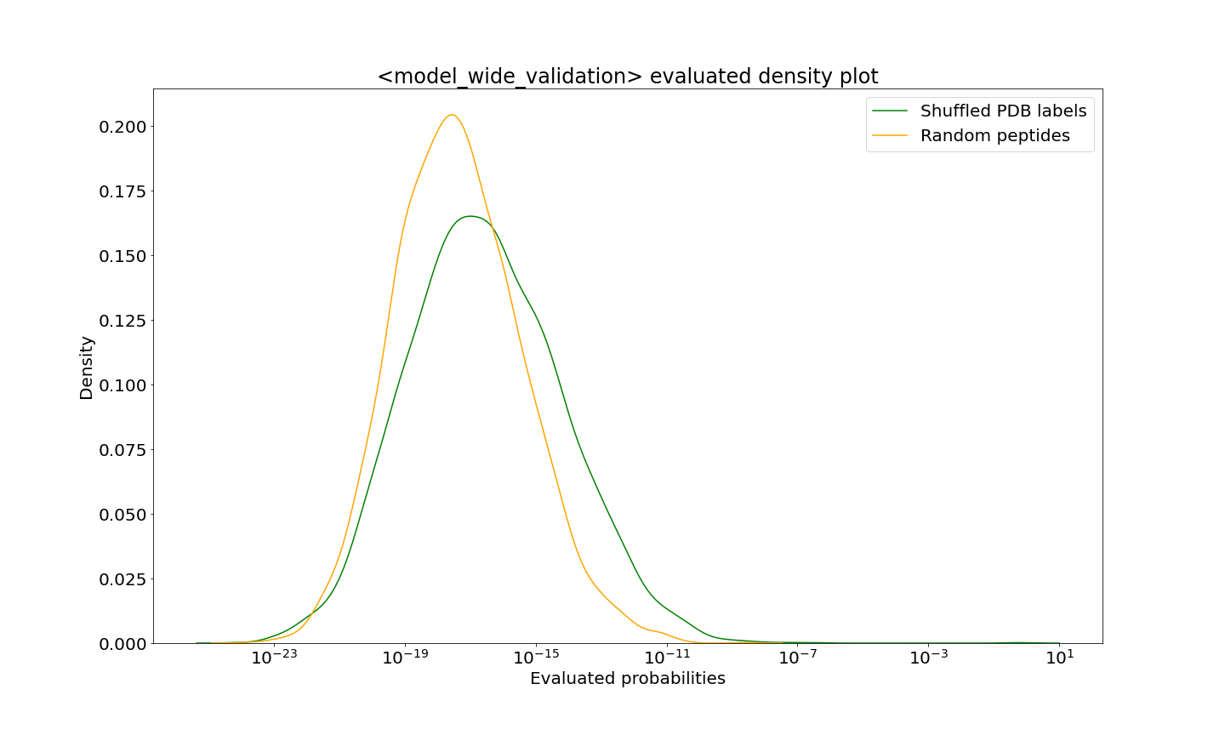
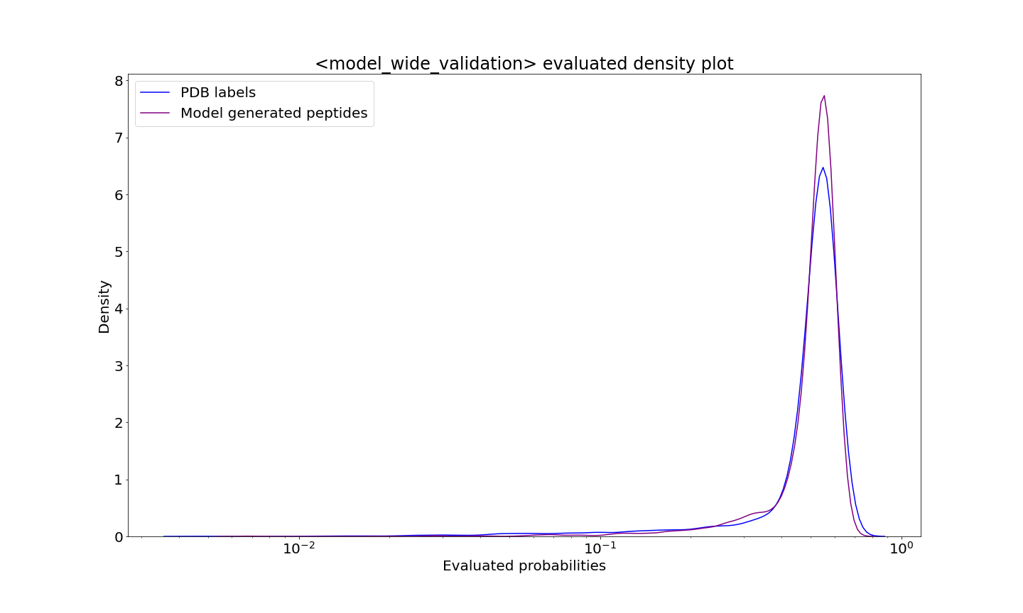
Model validation results – probability evaluation

Slide 12
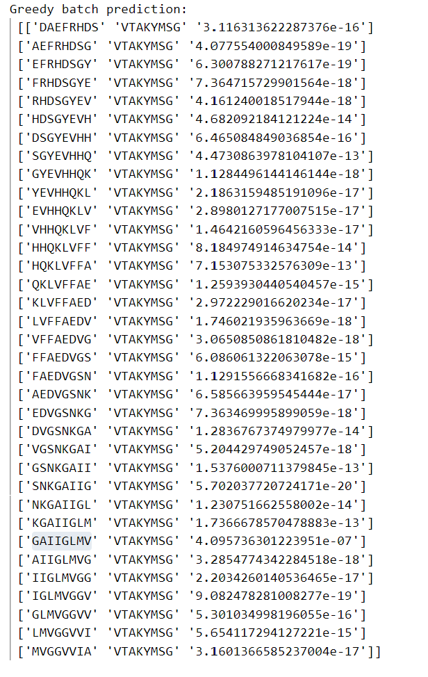
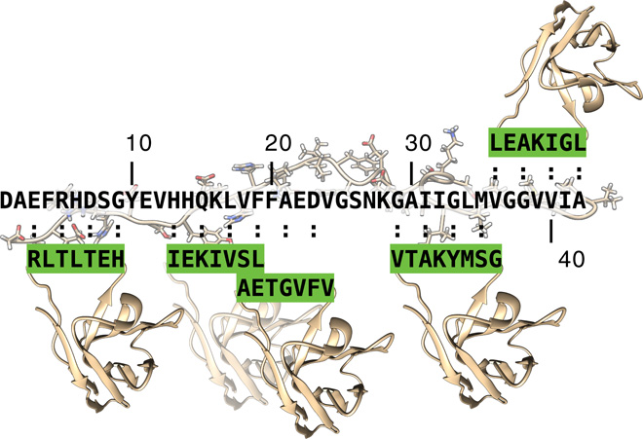
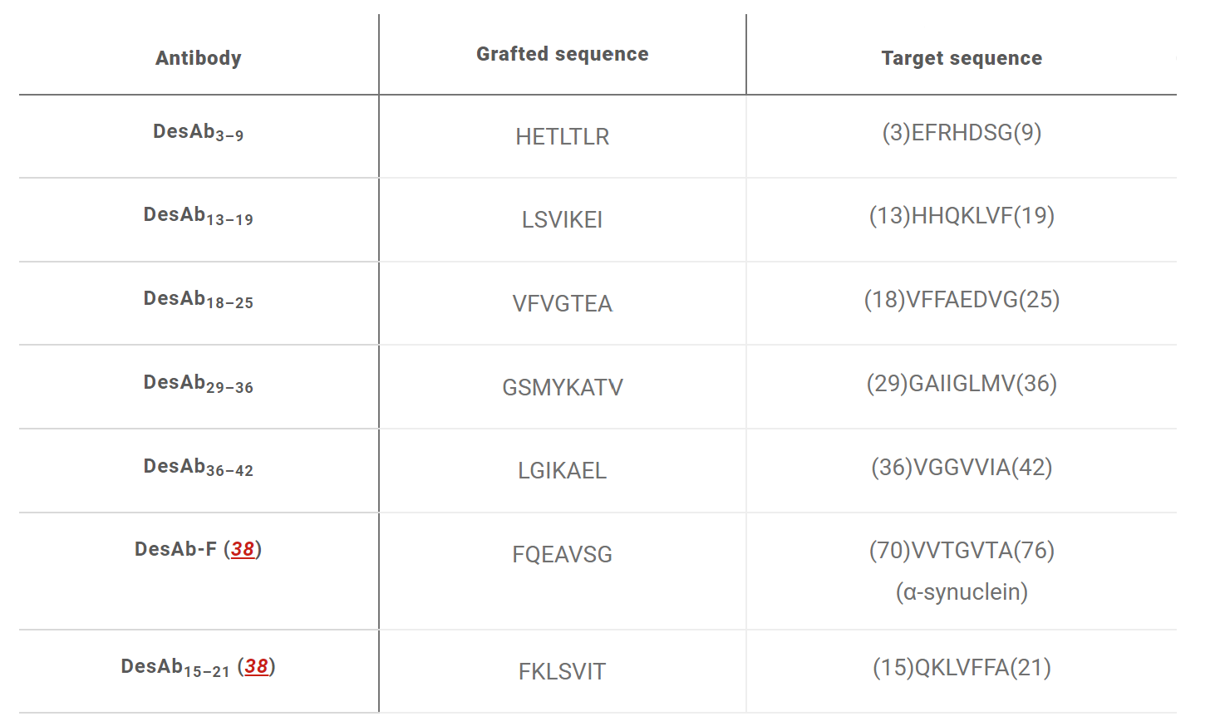
Model validation results -- DesAb_{29–36}
Fig. 1. Aprile, F. A., Sormanni, P et al. 2017. SCIENCE ADVANCES.
Table 1. Aprile, F. A., Sormanni, P et al. 2017. SCIENCE ADVANCES.

Slide 13
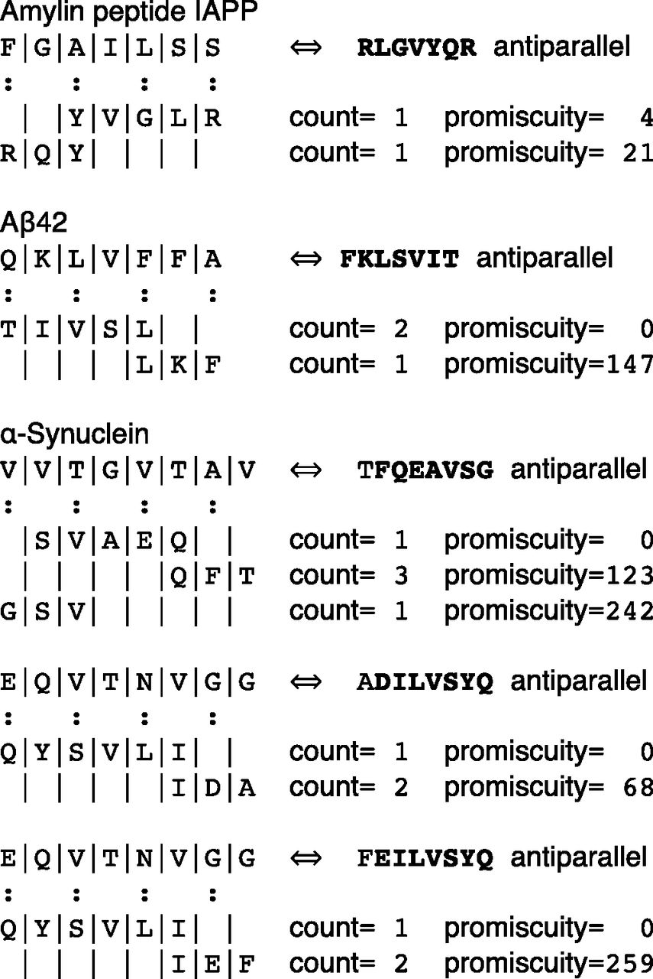
Model simulations on α-Synuclein, Aβ42, IAPP
Fig. S1. Sormanni, P., Aprile, F. A., & Vendruscolo, M. 2015. PNAS.

Slide 14
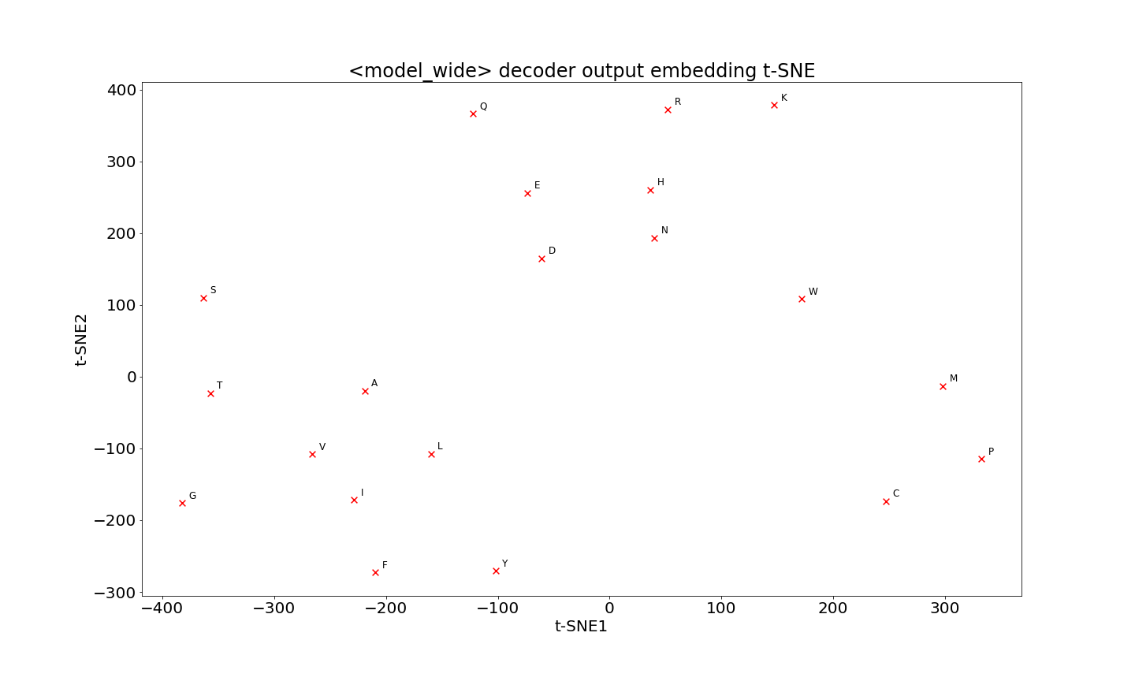
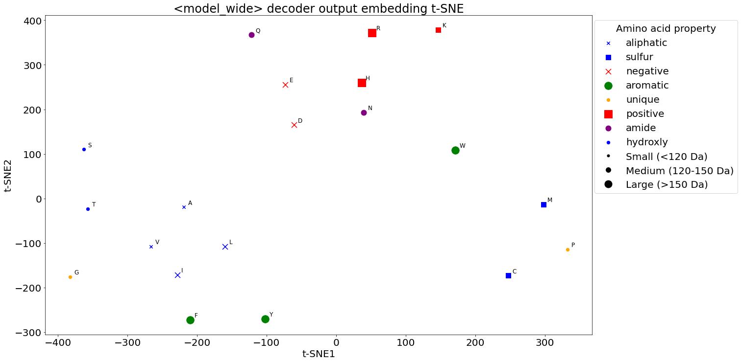
Model interpretation – amino acid embeddings

Slide 15
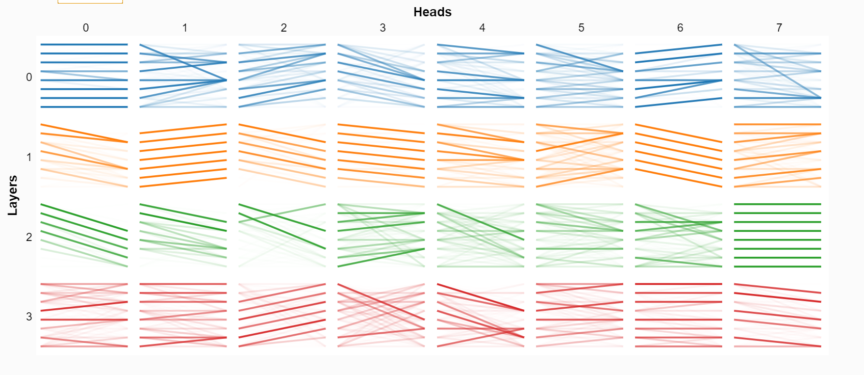
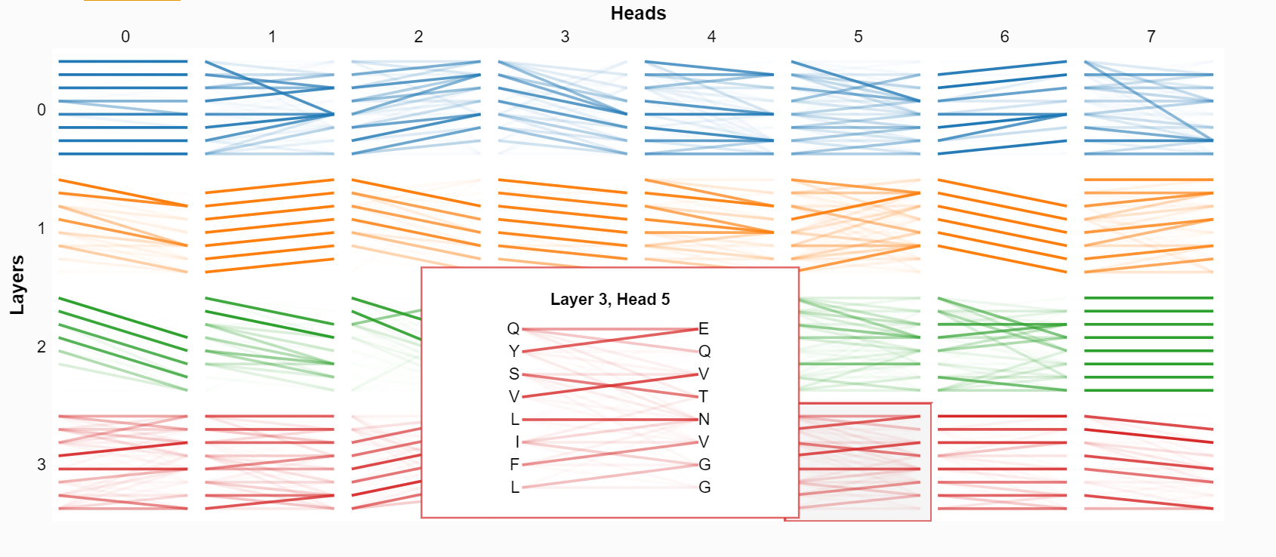
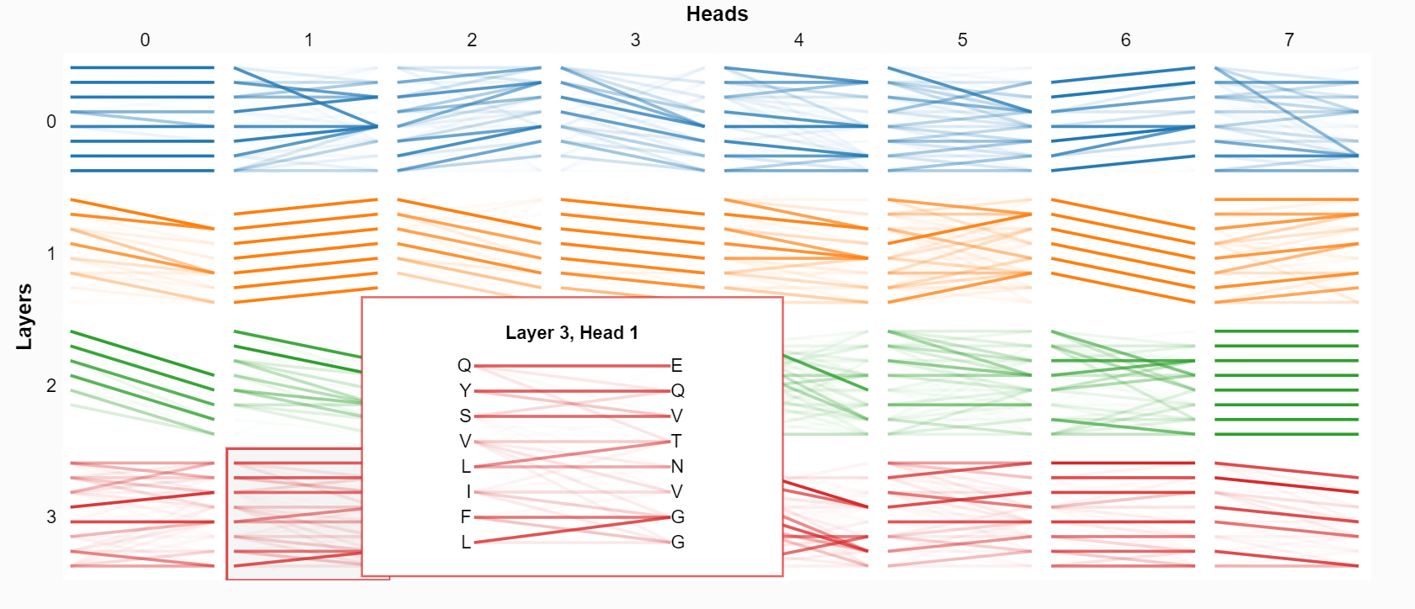
Model interpretation – attention visualization

Slide 16
Advantages of Transformer Model
Capable of generating peptides for any target sequence (Max length 8, potentially longer)
Capable of generating a diverse range of peptides for experiments
Capable of generating infinite peptides that are ranked with a probability
Efficient algorithm for greedy prediction and sampling
Potential to finetune this model to do downstream tasks (hydrogen bonding pattern prediction, parallel/anti prediction, any other biochemical property prediction, etc)
Potential to model other interactions
A lot improvement could be done if incorporating biology knowledge and lab results

Slide 17
Open questions
How does this model perform in lab?
How does this model compare to cascade method in practice?

Slide 18
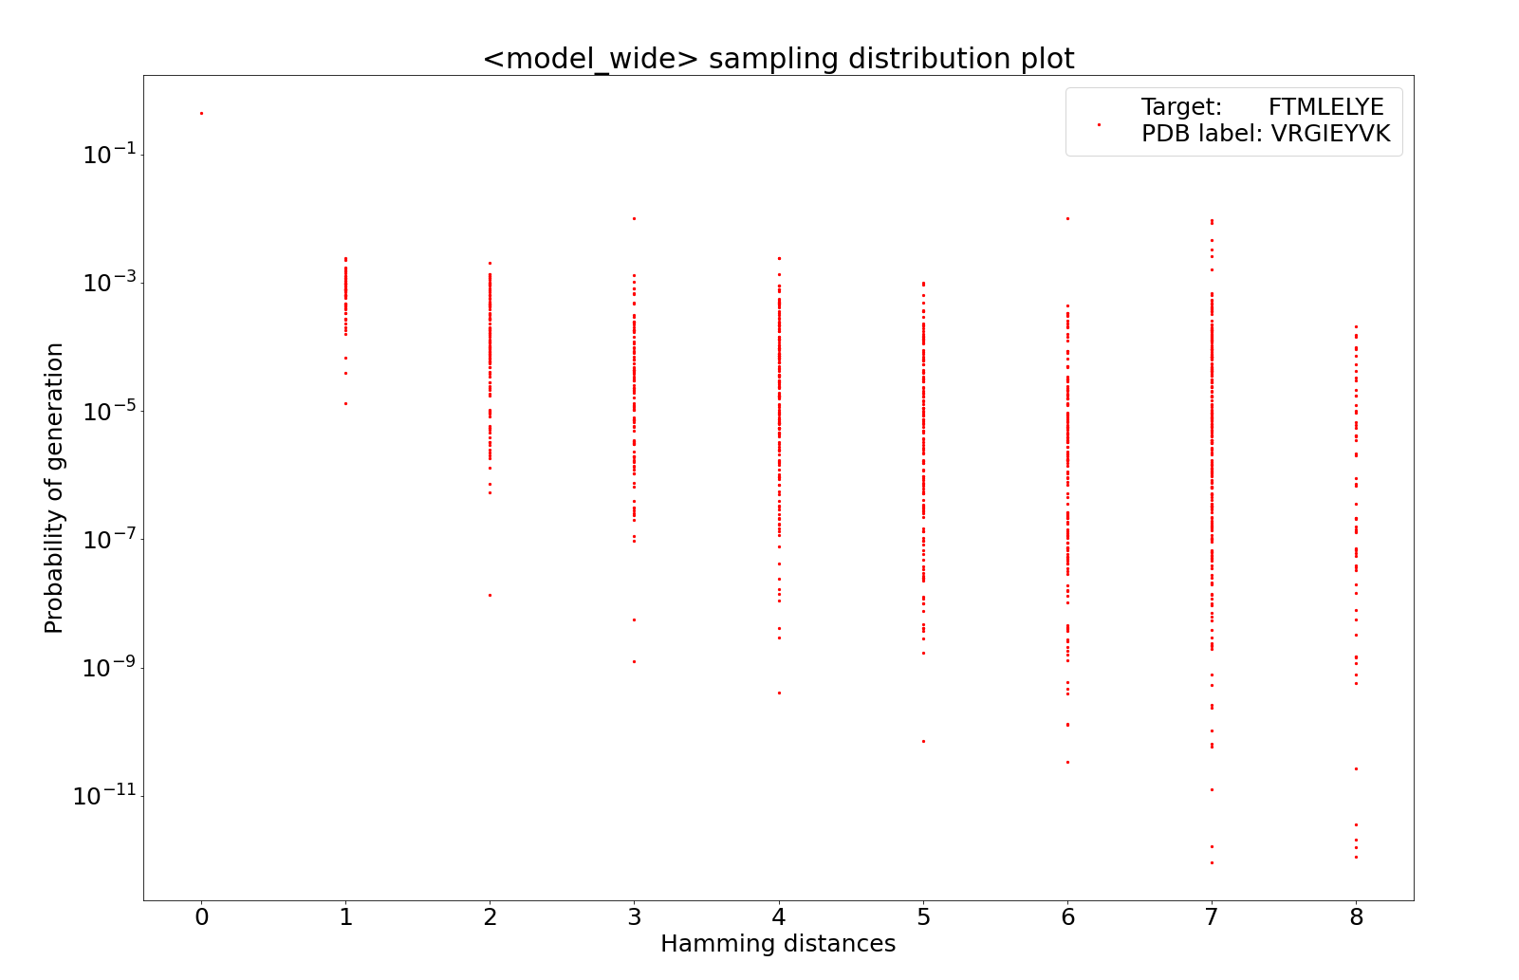
Supplementary Figure 1

